Slide 1


INTRODUCTION TO MACHINE LEARNING
MATERNAL HEALTH RISK

Slide 2
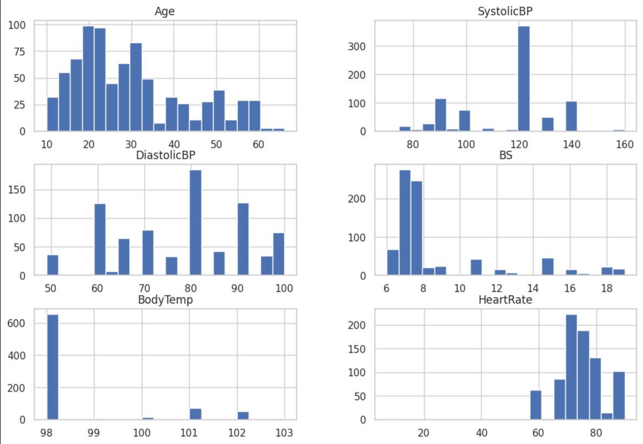
About The Data
The pregnancy dataset captures the delicate dance between age, vital signs, and health risk levels of expectant mothers. It offers a window into the extraordinary biological journey of bringing new life into the world, inviting us to uncover the patterns and insights that lie within the data.
KNN: Works well for clustered features like Age and BodyTemp; scaling is needed due to differing ranges (e.g., SystolicBP vs. HeartRate).
Random Forest: Handles high variance and outliers well (e.g., in DiastolicBP and BS); no scaling needed.
Non-Linear SVM: SVM uses kernel functions, like polynomial or RBF, to classify non-linearly separable features by transforming data into higher-dimensional space. The class_weight='balanced' option adjusts class weights to handle imbalanced distributions.
HISTOGRAMS

Slide 3
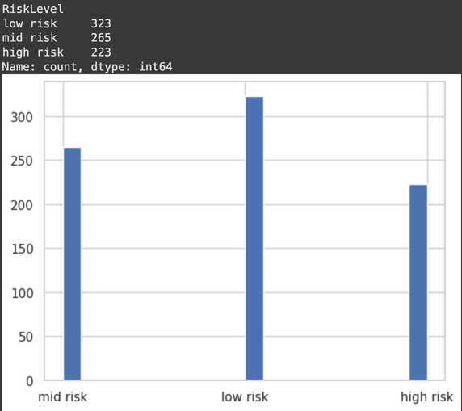
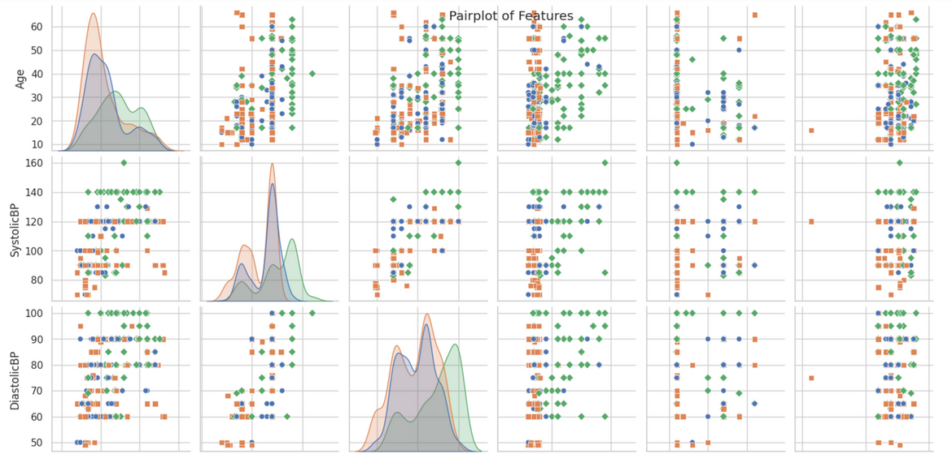
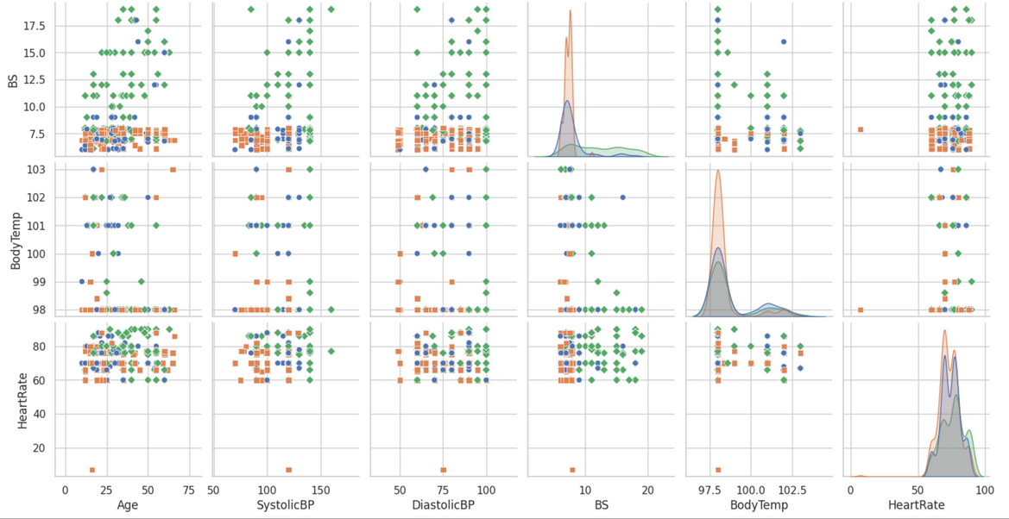
Exploratory Data Analysis
Distribution of three classes as given in data
The pair plots reveal varying degrees of separation among classes in feature spaces, indicating that some features may help differentiate classes better than others. K-Nearest Neighbours (KNN) is suitable here because certain clusters and local groupings are visible, allowing it to classify based on proximity.
Random Forest can effectively leverage the dataset's complex relationships and interactions between features through its ensemble of decision trees, handling non-linear separations observed in several plots. Linear SVM, while not ideal for highly overlapping data, may still capture basic linear separations for pairs with clearer boundaries, though it might struggle in more mixed regions. Together, these models can leverage different aspects of the feature distributions to improve classification.

Slide 4
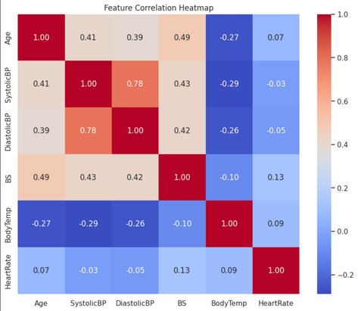
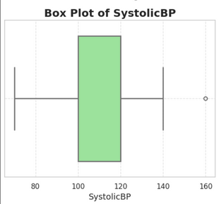
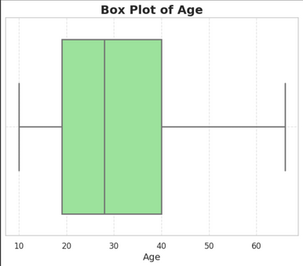
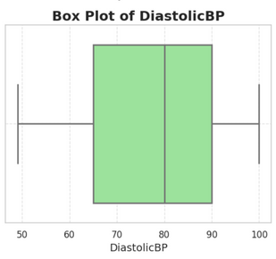
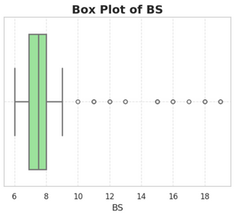
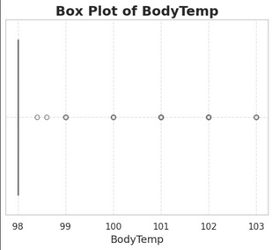
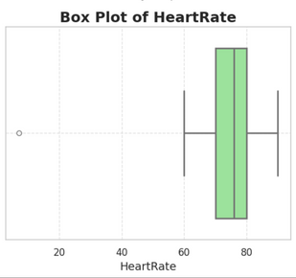
SystolicBP and DiastolicBP are strongly correlated (0.78), meaning they increase or decrease together.
Blood Sugar (BS) has moderate positive correlations with Age, SystolicBP, and DiastolicBP, suggesting these factors might rise together, potentially indicating health risks.
Age and BodyTemp have a weak negative correlation (-0.27), hinting that body temperature slightly decreases with age.
Heart Rate and Body Temperature show very weak correlations with most other features, indicating relative independence.
Outliers
In the Age plot, there are no outliers as all data points fall within the whiskers. In the SystolicBP plot, there is one outlier at around 160, indicating a value significantly higher than the rest of the data.
the DiastolicBP plot shows no outliers, as all values fall within the whiskers. However, in the BS (Blood Sugar) plot, there are multiple outliers extending beyond the upper whisker, indicating several high blood sugar values that deviate significantly from the main data distribution.
In the "Box Plot of BodyTemp," there are several outliers around the 98°F mark, indicating individuals with body temperatures below the interquartile range.
In the "Box Plot of HeartRate," one outlier is seen at a low heart rate (around 20 bpm), which lies outside the range of the central distribution. This may represent an anomalous or exceptionally low heart rate value.

Slide 5
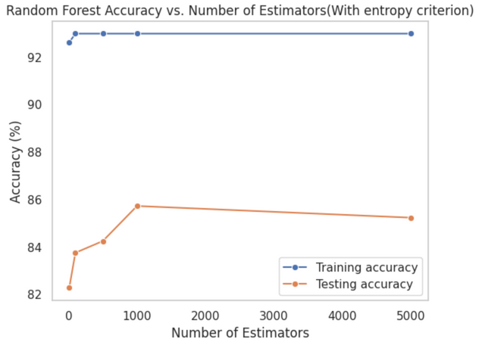

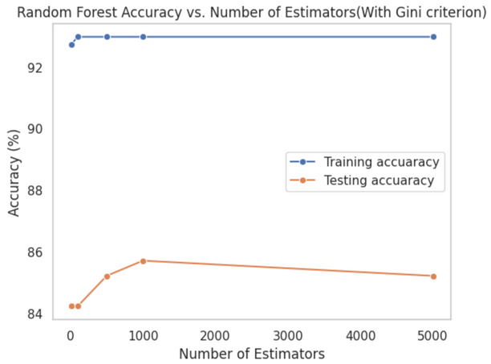
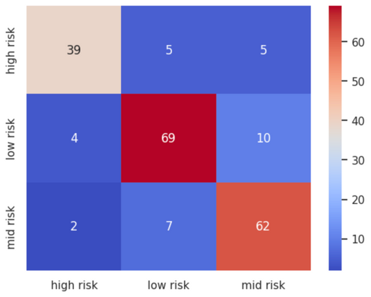
Random Forest Classifier
ENSEMBLE OF DECISION TREES
VOTING MECHANISM
ADVANTAGES AND LIMITATIONS
A Random Forest Classifier creates multiple decision trees from different subsets of data and features, making it a robust ensemble method that reduces overfitting.
Each tree "votes" on the predicted class, and the final classification is based on the majority vote across all trees, improving accuracy and reliability.
Random Forests handle large datasets well, provide feature importance, and are less prone to overfitting, but they can be computationally expensive and harder to interpret than individual trees.
Default and Tuned Performance: The RFC with default parameters achieved an accuracy of 84.26%. Using GridSearchCV, the optimal configuration with gini criterion, 100 estimators, and max depth of 20 yielded a accuracy score of 83.74 on test data.
Robustness to Outliers: RFC was applied without outlier removal since its ensemble approach minimizes the impact of outliers by averaging across multiple trees.
Gini vs. Entropy Criteria: For both gini and entropy criteria, training accuracy initially increased, then leveled off, while testing accuracy peaked around 1000 estimators before decreasing, likely due to noise capture in larger models.

Slide 6
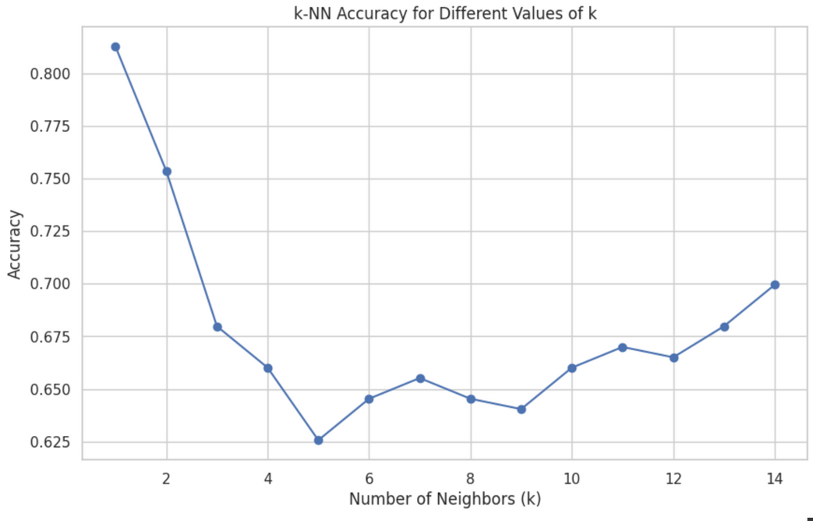
KNN (K- Nearest Neighbour)
INFORMATION
INFORMATION
VInstance-Based Learning: K-Nearest Neighbors (KNN) is a simple, instance-based algorithm used for both classification and regression. It doesn’t learn a model from the training data; instead, it memorizes the training instances to make predictions.
Hyperparameter K: The number of neighbors, K, is a critical parameter that controls the algorithm’s behavior. Small Kvalues make the model sensitive (can lead to overfitting), while large K values make it more generalized (can lead to underfitting).
Similarity-Based Prediction: For a new data point, KNN identifies the K closest data points (neighbors) from the training set based on a distance metric (e.g., Euclidean distance). The prediction is made based on the majority label (for classification) or the average of neighbors' values (for regression).
Non-Parametric and Lazy: KNN makes no assumptions about data distribution and doesn’t compute until prediction time, making it memory-intensive and slower on large datasets since it searches the entire dataset for each prediction
We initially set k=15 for our KNN model but observed peak accuracy at k=1 on the training set, raising concerns about overfitting. To investigate, we performed 5-fold cross-validation, where the dataset is split into five parts, each serving once as the validation set while the other four are used for training. This approach allows every data point to be used for both training and validation.
Cross-validation confirmed that the highest accuracy of 80.2% was consistently achieved at k=1 indicating the model generalizes well and is not simply overfitting the training set.

Slide 7
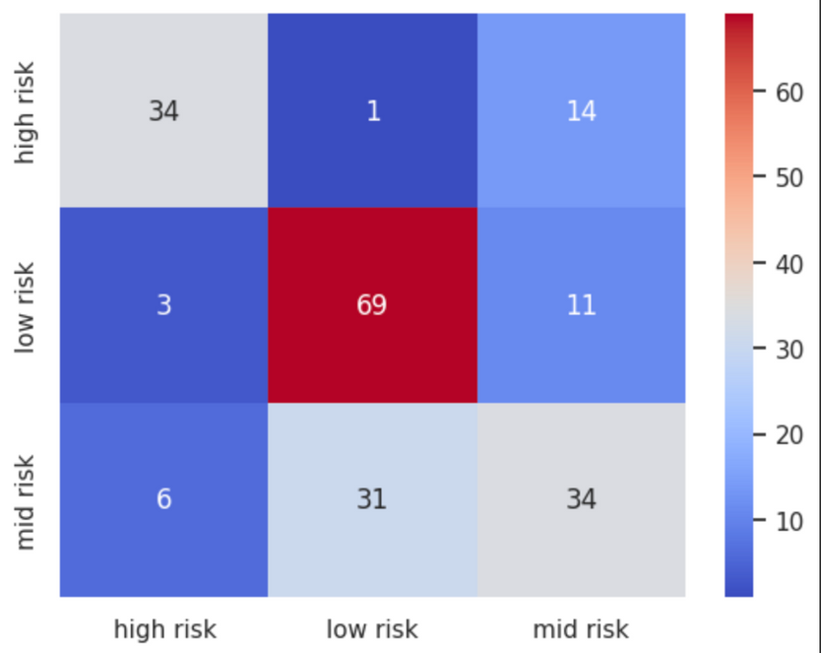


SVM (Support Vector Machine)
Maximizing the Margin: SVM identifies the hyperplane that separates classes while maximizing the margin between the closest data points (support vectors) of each class.
Support Vectors: The closest points to the decision boundary, known as support vectors, are critical for defining the hyperplane; removing other points doesn’t impact the model.
Kernels for Non-Linearity: SVM uses kernel functions (e.g., linear, polynomial, RBF) to transform data into higher dimensions, allowing for the separation of non-linearly separable classes.
Regularization Parameter C: The parameter C balances the margin width and classification accuracy, with a small C allowing misclassifications for a wider margin, while a large C focuses on minimizing errors, which can lead to overfitting.
We defined a hyperparameter grid for tuning SVM parameters, including C, kernel types, gamma, and polynomial degrees, using “rbf” and “polynomial” kernels (excluding “linear” due to the non-linear nature of the data). To handle class imbalance, we used stratified K-fold cross-validation, ensuring class proportions remained consistent across folds. Using GridSearchCV, we identified the best parameters as {′C′:10,′degree′:2,′gamma′:0.1,′kernel′:′rbf′} achieving 71.64% cross-validation accuracy, with 75.24% on the training set and 67.48% on the test set.

Slide 8




IIT JODHPUR
Thank you!
+91 8986885689
aj281004@gmail.com

